Slide 1
Do now
1. Compare opportunity versus stratified sampling (4)
2. How far did you get up to yesterday?
3. What do you need to do to get an A in Psychology?
What skills do you need to demonstrate?
Reminders:
Phones away
Bags on floor
Books out
Pens out
Whiteboard
Reminders
Assessment 2: (due Week 8) Investigation: Mnemonic devices

Slide 2
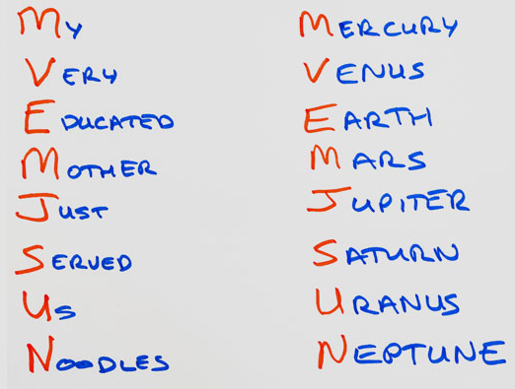
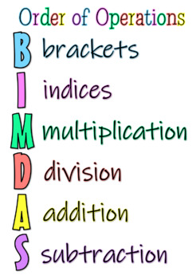
Assessment 2: Investigation Do mnemonic devices improve memory?
Reminders
Assessment 2: (due Week 8) Investigation: Mnemonic devices

Slide 3

Learning Intention
By the end of the lesson I will be able to:
I will know how to get an A in this subject.
I will be able to explain what is expected of me in the next assessment
Success Criteria
Everyone
Compared an A, B, and C grade investigation in General Psychology
Started drafting my introduction

Slide 4
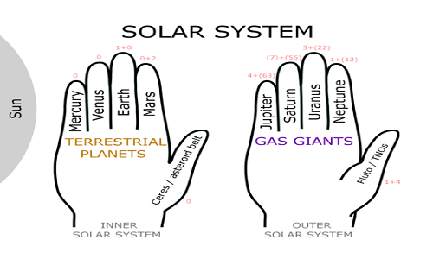
Assessment 2 Info
LO: Understand how to ace the next assessment
But Ms, what will you be doing?
Writing an Investigation under test conditions.
The investigation topic: do mnemonic devices improve memory?
You will have 5 lessons to prepare.
What can you bring with you?
You can bring 1 A4 page of bullet point notes, your results section and references can be completed already also.
Concept Development
Example of a mnemonic
Lesson 1 (today) | Lesson 2 (Tuesday 16th) | Lesson 3 | Lesson 4 | Lesson 5
Understand the assessment Introduction writing | Data collection Method writing Finish introduction | Analysing your data making your table and graph | Interpreting results Discussion section Peer Feedback | - Last day to finish notes / results section
5 MINUTE TASK:
Read the information letter and consent form
Read the assessment task sheet and marking key
Any questions?

Slide 5
Whiteboard reminders.
Write it – start writing your answer
Chin it – Show me your answers
Bin it – Wipe your whiteboard clean
Park it – Lids back on whiteboard markers and whiteboard down
Norms and rules:
1. Do not waste the ink – these pens are for learning and Ms Davey buys the pens (they are expensive).
2. Include everyone – Person who is writing the answer cannot research the answer (use your team, communicate). Swap roles each turn.
3. Be an active learner! – Using the whiteboards get you rehearsing information, making it easier to recall later. It also lets me know what you know and don’t know.

Slide 6
Activate prior knowledge
Create an operational hypothesis for the investigation.
3 minutes then chin in!
Notes:
Teacher questions:
What are the three divisions of the brain?
What is the oldest part of the brain?

Slide 7
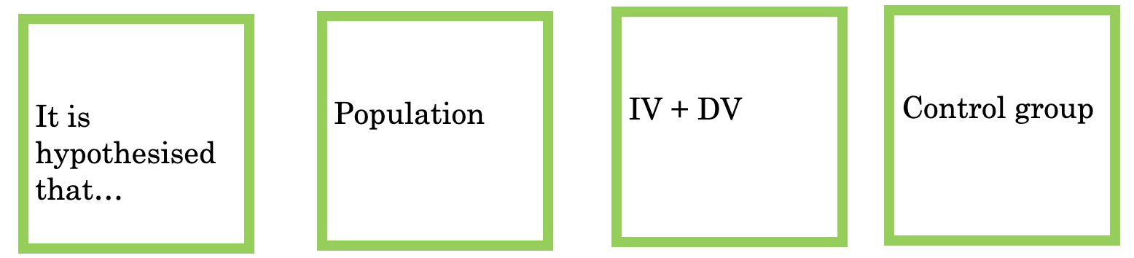
Check your operational
Hypothesis has all the right components…
Activate prior knowledge
Notes:
Teacher questions:
What are the three divisions of the brain?
What is the oldest part of the brain?

Slide 8
Activate prior knowledge
TASK: Open up “resource 2” grade descriptors
On your whiteboard:
Compare the differences between an A, B, and C
A grade | B grade | C grade
3 minutes then chin in!
Notes:
Teacher questions:
What are the three divisions of the brain?
What is the oldest part of the brain?

Slide 9
Activate prior knowledge
TASK:
In pairs compare the 3 investigation examples
Compare and evaluate what grade you would give them
3 minutes then chin in!
Notes:
Teacher questions:
What are the three divisions of the brain?
What is the oldest part of the brain?

Slide 10
Activate prior knowledge
Explain the purpose of an introduction on a research paper
2 minutes then chin in!
Notes:
Teacher questions:
What are the three divisions of the brain?
What is the oldest part of the brain?

Slide 11
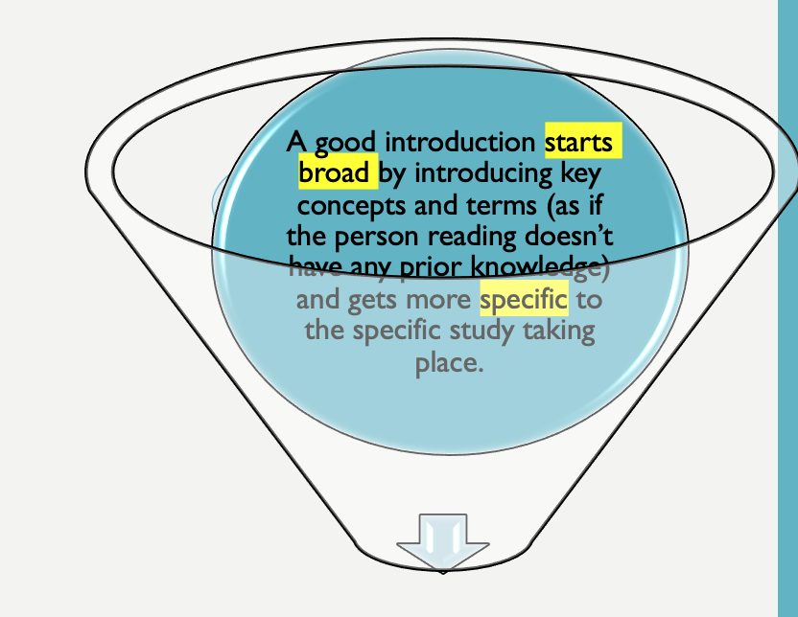
INTRODUCTION
Independent practice
To include, in order:
Define all the key terms: memory, mnemonic devices and narrative chains
Provide an example of a mnemonic device
Outline relevant previous research
Link current research to past. Why are you now conducting the research?
Aim and operational hypothesis of current research
Variables defined (IV, and DV)
Sentence starters…
Memory is defined as…
The current research is looking at how…
Past research by X and X (2019) found that…

Slide 12
Refresher: what are mnemonics?
Concept development
What are mnemonic devices? Any learning technique that aids information retention & retrieval of memory. Mnemonics make use of elaborative encoding, retrieval cues, and imagery as specific tools to encode any given information in a way that allows for efficient storage and retrieval.
Narrative chain: Creating a visual, memorable sentence, strining together key words that you need to remember in order.
e.g. Cat, leaf, wind, = A pink cat is chasing a giant leaf blowing in the wind.
Remember for your assessment this needs to be in your own words with your own example

Slide 13
Reading and summarizing previous research
Steps:
Open resource 3: Literature
Pick out the researchers and year
e.g. Davey (2019)
2) From the research identify:
Aim, Participants, Procedure, Results and Conclusion
3) Evaluate the research – are there any flaws in the method?
Include a brief outline in your introduction.
Step 3 allows you to link the past research to the current.
Sentence starters..
Research conducted by…
The efficacy of mnemonic d devices has been test by…
Previous research by… looked at…
Independent practice
You need at least 3 sources to cite from in your introduction.
Look on the next slide for potential sources and citing tips.

Slide 14
Introduction – needs at least 3 Journal Articles!
Independent practice
Use citeme.com to put your references into APA formatting​
Articles​
https://psychcentral.com/lib/memory-and-mnemonic-devices/​
https://www.sciencedirect.com/topics/psychology/mnemonics​
Journal Articles​
https://niallaocallaghan.files.wordpress.com/2014/10/posterpdf.pdf​
https://stanford.edu/~gbower/1969/Narrative_stories.pdf​
https://www.bartleby.com/essay/The-Effectiveness-of-Narrative-Chaining-on-Memory-FKJWZBFCTC​
https://www.ncbi.nlm.nih.gov/pmc/articles/PMC5439266/​
https://www.tandfonline.com/doi/full/10.1080/10691898.2017.1294879​
https://link.springer.com/content/pdf/10.3758/BF03336829.pdf

Slide 15

Homework
Before next class you must have:
Drafted your introduction, including summarising previous research

Slide 16

Exit Ticket
Ask one get one

